Slide 1

CSC 1004: Tutorial 10
Tkinter Introduction, and Function implementation (1)
Guanren Qiao
SDS, CUHK-SZ

Slide 2
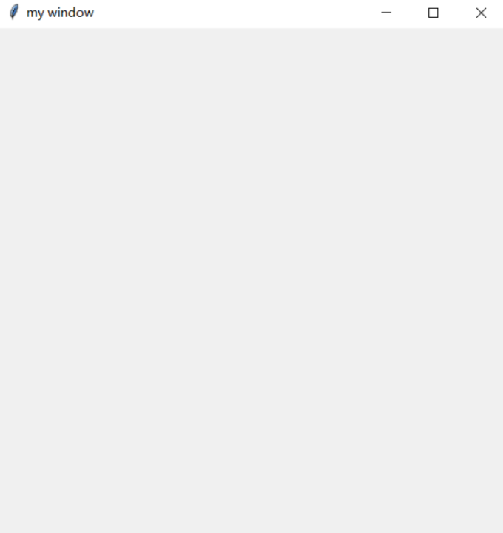
Tkinter mainloop
if you want to create a Tkinter GUI
import tkinter
window = tkinter.Tk()
window.title('my window')
window.geometry('500x500')
window.mainloop()

Slide 3
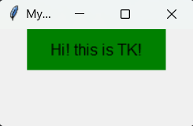
Tkinter Label (1)
import tkinter as tk
window=tk.Tk()
window.title('Mywindow')
window.geometry('200x100')
l = tk.Label(window,
text='Hi! this is TK!',
bg='green',
font=('Arial', 12),
width=15,
height=2
)
l.pack()
window.mainloop()

Slide 4
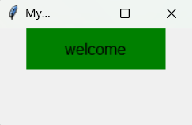
Tkinter Label (2)
import tkinter as tk
window=tk.Tk()
window.title('Mywindow')
window.geometry('200x100')
var=tk.StringVar()
var.set(‘welcome’)
l = tk.Label(window,
textvariable=var,
bg='green',
font=('Arial', 12),
width=15, height=2)
l.pack()
window.mainloop()

Slide 5
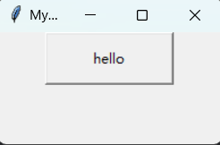
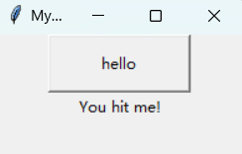
Tkinter Button
import tkinter as tk
window=tk.Tk()
window.title('Mywindow')
window.geometry('200x100')
on_hit=False
var = tk.StringVar()
def hit_me():
global on_hit
if on_hit==False:
on_hit=True
var.set('You hit me!')
else:
on_hit=False
var.set('')
b=tk.Button(window,text='hello',width=15,height=2,command=hit_me)
b.pack()
label = tk.Label(window, textvariable=var)
label.pack()
window.mainloop()

Slide 6
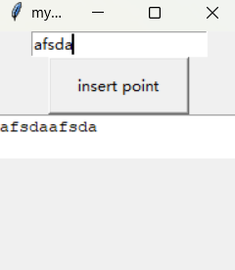
Tkinter Entry & Text
import tkinter as tk
window = tk.Tk()
window.title('my window')
window.geometry('200x200')
e=tk.Entry(window,show=None)
e.pack()
def insert_point():
var=e.get()
t.insert('insert',var)
b = tk.Button(window,text="insert point",width=15,
height=2,command=insert_point)
b.pack()
t=tk.Text(window,height=2)
t.pack()
window.mainloop()

Slide 7
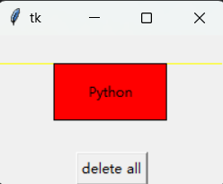
Tkinter Canvas
import tkinter as tk
root = tk.Tk()
w = tk.Canvas(root, width =200, height = 100)
w.pack()
line1 = w.create_line(0, 50, 200, 50, fill = "yellow")
line2 = w.create_line(100, 0, 100, 100, fill = "red", dash = (4, 4))
rect1 = w.create_rectangle(50, 25, 150, 75, fill = "blue")
w.coords(line1, 0, 25, 200, 25)
w.itemconfig(rect1, fill = "red")
w.delete(line2)
w.create_text(100, 50, text = "Python")
tk.Button(root, text = "delete all", command = (lambda x = "all" : w.delete(x))).pack()
root.mainloop()

Slide 8
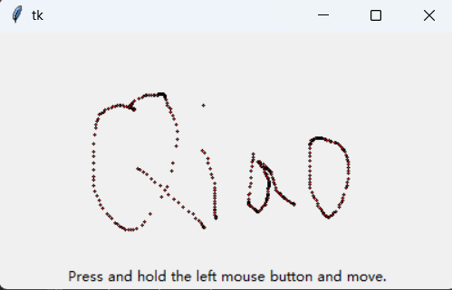
Tkinter Canvas
import tkinter as tk
root = tk.Tk()
w = tk.Canvas(root, width = 400, height = 200)
w.pack()
def paint(event):
x1, y1 = (event.x - 1), (event.y - 1)
x2, y2 = (event.x + 1), (event.y + 1)
w.create_oval(x1, y1, x2, y2, fill = "red")
w.bind("<B1-Motion>", paint)
tk.Label(root, text = "Press and hold the left mouse button and move.").pack(side = "bottom")
root.mainloop()

Slide 9
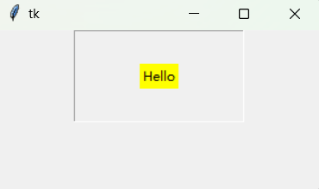
Tkinter Frame
from tkinter import *
root=Tk()
root.geometry('300x150+888+444')
fr1=Frame(root,relief='groove',bd=1,padx=60,pady=30)
fr1.pack()
la1=Label(fr1,text='Hello',bg='yellow')
la1.pack()
root.mainloop()

Slide 10
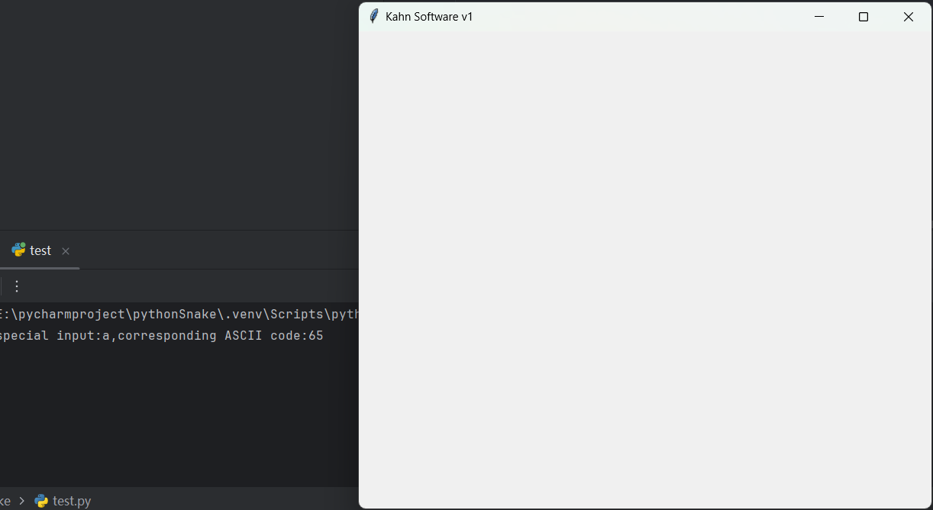
Tkinter key_event
import tkinter
def xFunc1(event):
print(f"special input:{event.char},corresponding ASCII code:{event.keycode}")
win = tkinter.Tk()
win.title("Kahn Software v1")
win.geometry("600x500+200+20")
win.bind("a", xFunc1)
win.mainloop()

Slide 11
Python Class (1)
class people:
#define basic(public) attribute
name = ''
age = 0
#define private attribute
__weight = 0
#initialization
def __init__(self,n,a,w):
self.name = n
self.age = a
self.__weight = w
def speak(self):
print("%s say: I %d years old。" %(self.name,self.age))
# Instantiate a class
p = people('runoob',10,30)
p.speak()

Slide 12
Python Class (2) Inheritance
class people:
name = ''
age = 0
__weight = 0
def __init__(self,n,a,w):
self.name = n
self.age = a
self.__weight = w
def speak(self):
print("%s 说: 我 %d 岁。" %(self.name,self.age))
class student(people):
grade = ''
def __init__(self,n,a,w,g):
people.__init__(self,n,a,w)
self.grade = g
def speak(self):
print("%s say: I’m %d years old，and my grade is %d"%(self.name,self.age,self.grade))
s = student('ken',10,60,3)
s.speak()

Slide 13
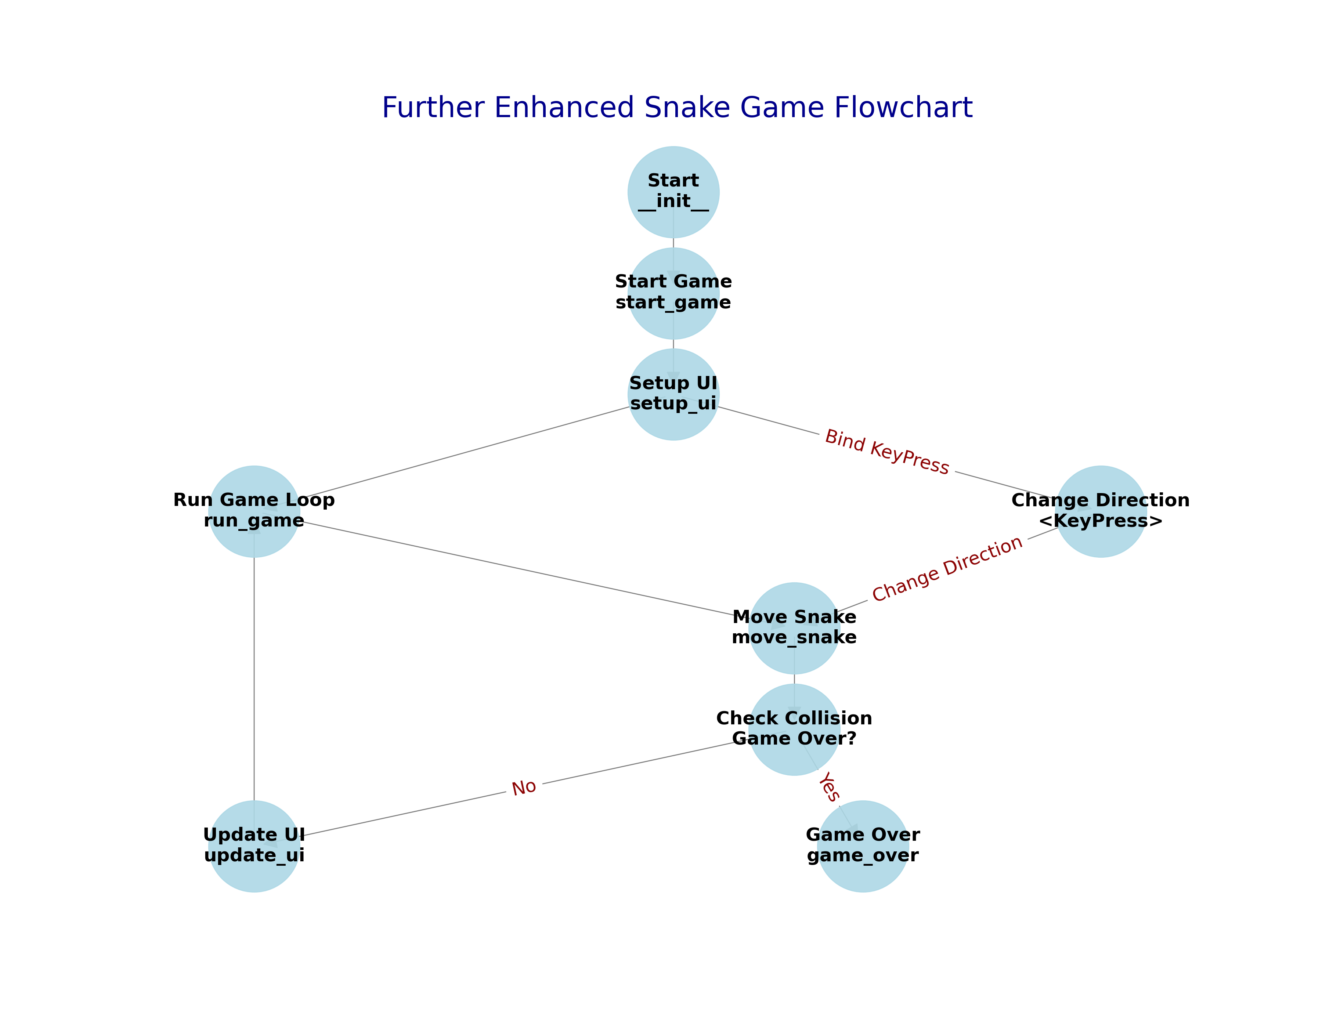
Review

Slide 14
Class SnakeGame and start_game function
class SnakeGame(tk.Tk):
def __init__(self):
super().__init__()
self.title("Snake Game")
self.geometry("800x800")
self.resizable(False, False)
self.width = 800
self.height = 800
self.cell_size = 20
self.snake_direction = 'Right'
self.snake = [(100, 100), (80, 100), (60, 100)]
self.food = self.create_food()
self.game_frame = tk.Frame(self)
self.canvas = tk.Canvas(self.game_frame, bg='black', width=self.width, height=self.height)
self.start_game()
def start_game(self):
self.game_frame.pack(fill="both", expand=True)
self.canvas.pack()
self.setup_ui()
self.run_game()
def setup_ui(self):
self.update_ui()
self.bind("<KeyPress>", self.change_direction)
def run_game(self):
self.move_snake()
self.after(100, self.run_game)

Slide 15
Create food and game over
def create_food(self):
while True:
x = random.randint(0, (self.width//self.cell_size)-1) * self.cell_size
y = random.randint(0, (self.height//self.cell_size)-1) * self.cell_size
food = (x, y)
if food not in self.snake:
return food
def game_over(self):
self.canvas.create_text(self.width//2, self.height//2, text="Game Over", fill="white", font=('TkDefaultFont', 24))
self.unbind("<KeyPress>")

